Slide 1
GOOD MORNING
EVERYONE !!!

Slide 2
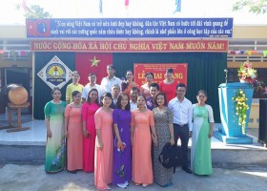
TAY SON SECONDARY SCHOOL
WELCOME TO EVERYBODY

Slide 3
Thursday, November 9th, 2017
Unit 4:
Our customs and traditions
Lesson 3: A closer look 2

Slide 4
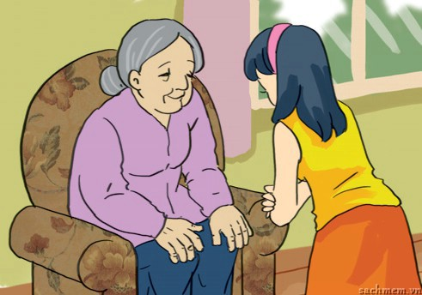
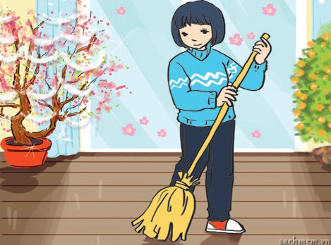
grammar
Should and shouldn’t to express advice: review
1. Look at the pictures and complete the sentences with should or shouldn’t. (Page 41)
should
2. According to tradition, you __________
sweep the floor on the first day of Tet.
1. You __________ respect old people.
shouldn’t

Slide 5
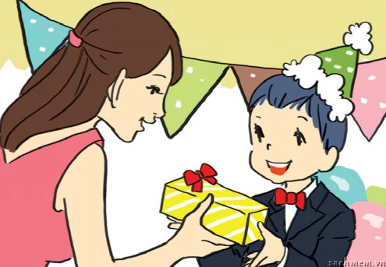
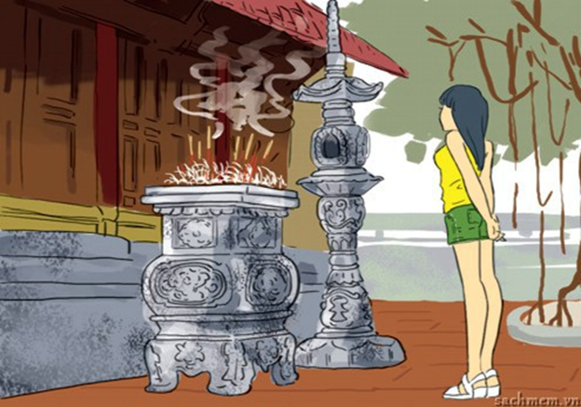
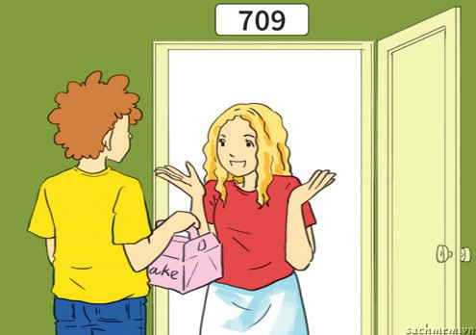
should
shouldn’t
3. Children __________ take things from adults with both hands.
4. You __________ wear shorts when going to the pagoda.
should
5. You __________ bring a gift when you visit someone’s house.

Slide 6
2. Match the situations in A and the advice in B. (Page 41)
1. Your sister is chewing and talking at the same time.
A. Shhhh! You should be quiet in here.
2. Your brother is noisy at the pagoda.
B. You shouldn’t do that. It’s not very polite.
C. After taking food from the plate, you should put it into your bowl before eating.
3. Your foreign friend has been invited to dinner in a Vietnamese house.
4. You don’t know what to do when going into a Japanese house.
E. You should arrive on time.
5. You have been invited to dinner with a British family.
D. You should take off your shoes at the entrance.

Slide 7
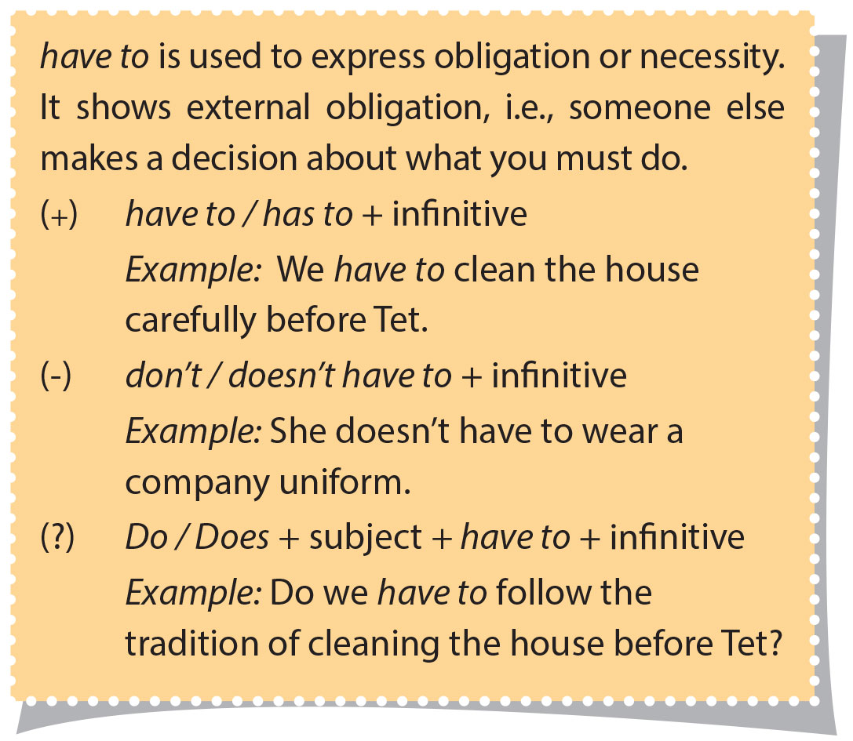
Have to to express obligation or necessity

Slide 8
Have to được dùng để thể hiện sự bắt buộc hoặc sự cần thiết. Nó thể hiện sự bắt buộc đến từ bên ngoài, ví dụ như một ai đó khác quyết định điều bạn phải làm.
Example:
(+)We have clean the house carefully before Tet.
(+) S + have to/ has to + infinitive.
(-) She doesn’t have to wear a company uniform.
(-) S + don’t/ doesn’t have to + infinitive.
(?) Do we have to follow the tradition of cleaning the house before Tet?
(?) Do/ does + S + have to + infinitive?

Slide 10
* Remember:
-Don’t have to được dùng khi không cần thiết thực hiện một hành động nào đó.
Ex: My mother doesn’t have to work on Saturdays.
Nếu bạn muốn bảo ai đó đừng làm gì đó, vì đó là sự bắt buộc, bạn nên dùng mustn’t hoặc must not để thay thế.
Ex: You mustn’t wear short skirts in here.

Slide 11
3. Complete the sentences with the correct form of have to. (Page 42)
have to
My mother says that I __________ be home by 9 p.m. sharp.
We __________ go now because our dad is waiting for us.
She __________ wear that costume because it’s the family tradition.
In the past, men __________ wear ao dai, but today they _______________ wear it.
Before leaving the dinner table, __________ your son __________ ask for permission?
We _______________ go to school today because it was raining heavily.
have to
has to
had to
don’t have to
does
have to
didn’t have to

Slide 12
4. Choose A or B to convey the meaning of the first sentence. (Page 42)
You have to take your hat off when going inside the main worship area of the temple.
A. You can take your hat off if you want to.
B. You’re not allowed to wear your hat.
You don’t have to tip in Viet Nam.
A. It’s not necessary to tip in Viet Nam.
B. You’re not allowed to tip in Viet Nam.
Students mustn’t run or be noisy in the school building.
A. Running and being noisy aren’t allowed in the school building.
B. They can run and be noisy if they want to.
In the past, Vietnamese people had to live with their parents even after they got married.
A. They could live with their parents after they got married.
B. They were obliged to live with their parents after they got married.

Slide 13
5. Mi is going to visit her friend Eri in Japan. Read Eri’s email. There are six mistakes in it. Can you find and correct them? (Page 42)
From: eri@fastmail.com
To: mi@quickmail.com
Hello Mi,
I’m so excited about your trip. It’s going to be amazing!
I shouldn’t give you some advice, so you can prepare for Japan. We have lots of customs and it can get a bit confusing for visitors. ☺
Firstly you has to take off your shoes when you go inside. You shouldn’t wear slippers in the house - but you didn’t have to bring any, we have extra pairs for guests. Then you have use different slippers in the bathroom and in the garden, but you’ll get used to it! You should worry - I’ll be there to help you.
All for now, gotta go…
Eri x

Slide 14
1
Hello Mi,
I’m so excited about your trip. It’s going to be amazing!
I shouldn’t give you some advice, so you can prepare for Japan.We have lots of customs and it can get a bit confusing for visitors. ☺
Firstly you has to take off your shoes when you go inside. You shouldn’t wear slippers in the house -but you didn’t have to bring any, we have extra pairs for guests. Then you have use different slippers in the bathroom and in the garden, but you’ll get used to it! You should worry - I’ll be there to help you.
All for now, gotta go…
Eri x
2
3
4
5
6

Slide 15
Mistake | Correct
shouldn’t give | should give
has to | have to
shouldn’t wear | should wear
didn’t have to | don’t have to
have use | have to use
should worry | shouldn’t worry

Slide 16
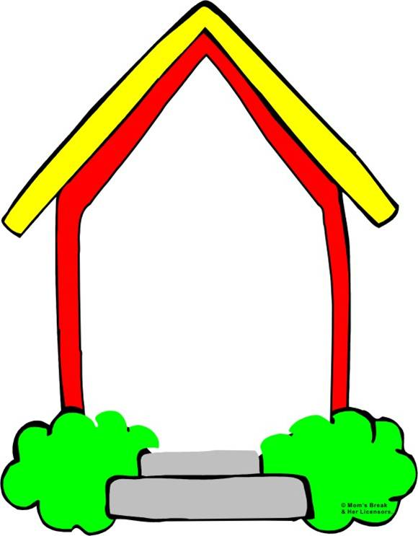
Homework
1. Write three advice and three obligations your friend should follow
2. Prepare next lesson.

Slide 17
Thank you for your attendance!

