Slide 1
Welcome to our class!
Teacher: Nguyen Thi Kim Thuy
School: Dai Son Primary and Secondary School

Slide 2
Warm-up

Slide 3
Magic Wheel
50
10
20
30
10
20
30
40
Spin
PLAY
LUẬT CHƠI
Nhấn nút để quay.
Trả lời đúng câu hỏi sẽ được cộng số điểm tương ứng vị trí mũi tên dừng.
Kết thúc trò chơi đội cao điểm hơn sẽ chiến thắng.
Spin
Notes:
Ms Huyền Phạm - 0936.082.789 – YOUTUBE: MsPham. Facebook: Dạy và học cùng công nghệ.

Slide 4
It’s a Vietnamese story about watermelon. What’s the name of
the story?
50
10
20
30
10
20
30
40
It’s the story of Mai
An Tiem.
Xem đáp án
Spin
Notes:
Ms Huyền Phạm - 0936.082.789 – YOUTUBE: MsPham. Facebook: Dạy và học cùng công nghệ.

Slide 5
Who is the main character in the story of Mai An Tiem?
50
10
20
30
10
20
30
40
Xem đáp án
Mai An Tiem.
Spin
Notes:
Ms Huyền Phạm - 0936.082.789 – YOUTUBE: MsPham. Facebook: Dạy và học cùng công nghệ.

Slide 6
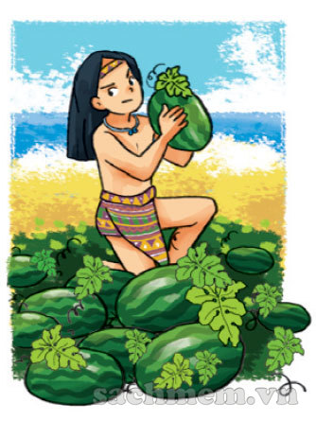
What’s An Tiem like?
50
10
20
30
10
20
30
04
Xem đáp án
He’s hard- working.
Spin
Notes:
Ms Huyền Phạm - 0936.082.789 – YOUTUBE: MsPham. Facebook: Dạy và học cùng công nghệ.

Slide 7
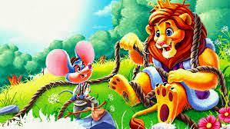
What are you reading?
50
10
20
30
10
20
30
04
Xem đáp án
I’m reading the lion and the mouse.
Spin
Notes:
Ms Huyền Phạm - 0936.082.789 – YOUTUBE: MsPham. Facebook: Dạy và học cùng công nghệ.

Slide 8
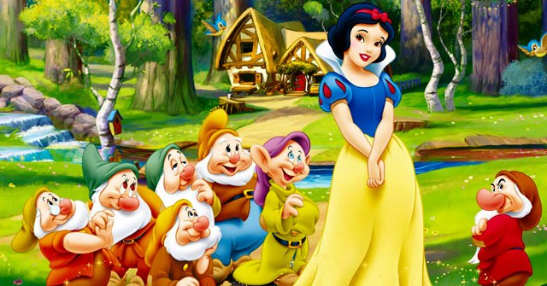
What’s Snow White like?
50
10
20
30
10
20
30
40
Xem đáp án
She’s kind.
Spin
Notes:
Ms Huyền Phạm - 0936.082.789 – YOUTUBE: MsPham. Facebook: Dạy và học cùng công nghệ.

Slide 9
What are the linking words to tell a story?
50
10
20
30
10
20
30
40
First then next
in the end
Xem đáp án
Spin
Notes:
Ms Huyền Phạm - 0936.082.789 – YOUTUBE: MsPham. Facebook: Dạy và học cùng công nghệ.

Slide 10
50
10
20
30
10
20
30
40
EXIT
Notes:
Ms Huyền Phạm - 0936.082.789 – YOUTUBE: MsPham. Facebook: Dạy và học cùng công nghệ.

Slide 11
6. Let’s play

Slide 12
Wednesday February 22nd, 2023
Unit 14:What happened in
the story?
Lesson 2: Part 1, 2, 3

Slide 13
1/Vocabulary

Slide 14
The Golden Starfruit Tree
:cây khế vàng

Slide 15
Vocabulary
100x2: 5 = 40
clever
intelligent
: thông minh

Slide 16
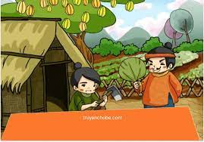
the older brother
anh trai

Slide 17
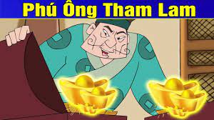
greedy
: tham lam

Slide 18
1/ Vocabulary
the older brother
: anh trai
intelligent
: thông minh
greedy
: tham lam
The golden Starfruit Tree
: cây khế vàng

Slide 19
Matching
1
the older brother
2
intelligent
3
The golden Starfruit Tree
4
greedy

Slide 20
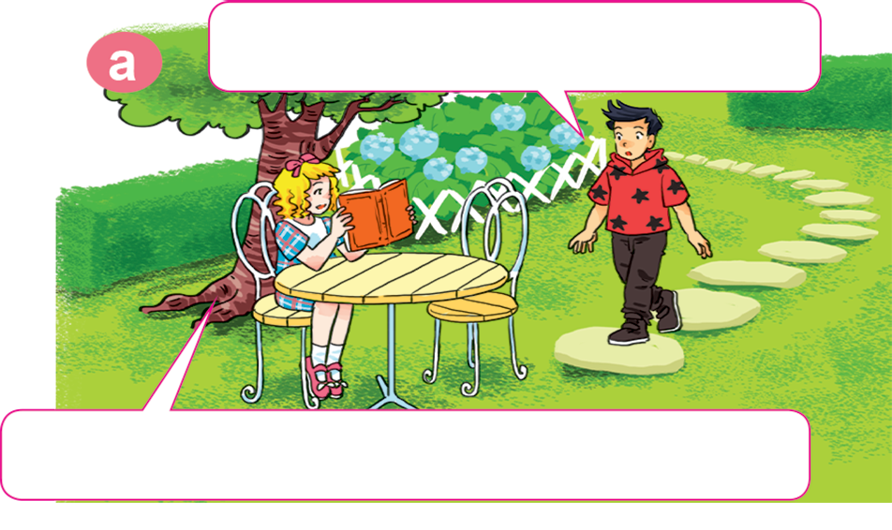

Slide 22
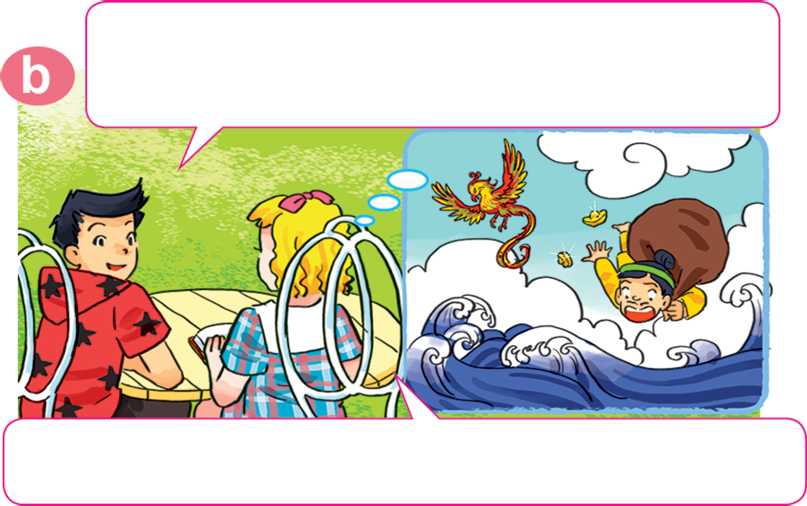
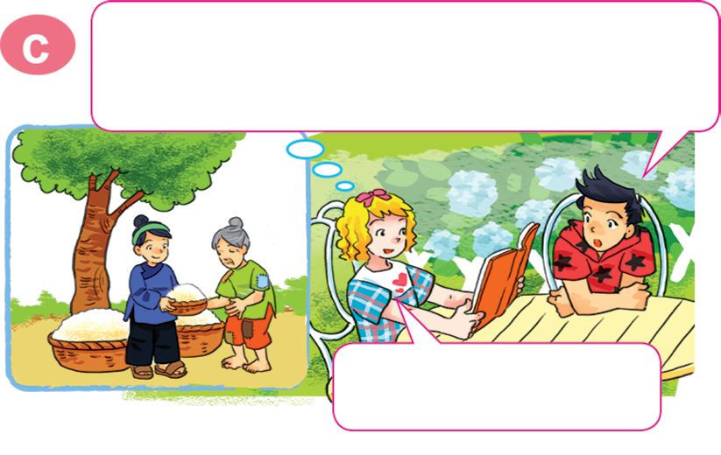
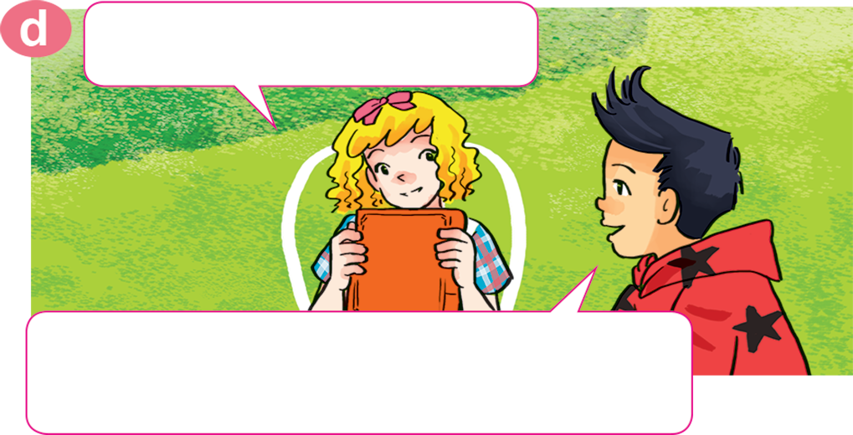
1. Look, listen and repeat.
What are you doing, Linda?
Oh, I read it last week. What do you think of the two brothers?
I'm reading The Golden Starfruit Tree.
I think the older brother is very greedy.
Yeah, you're right. How about the younger one?
Do you like the story?
Yes, I do. We can learn a lesson from it: don't be so greedy!
He's very kind.

Slide 23
What do you think of the older brother?
What do you think of the two brothers?
I think the older brother is very greedy.
he

Slide 24
2. Model sentences:
Hỏi và trả lời quan điểm của ai đó về tính cách nhân vật:
What do you think of the older brother?
I think he’s very greedy.
Note: he’s = he is

Slide 26
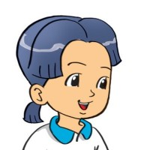
2. Point and say
What do you think of __________?
I think ____________.
the mouse
it's intelligent

Slide 28
2. Point and say
a
What do you think of __________?
I think ____________.
the mouse
it's intelligent

Slide 29
b
What do you think of _________?
I think ________________.
An Tiem
he’s hard-working

Slide 30
c
What do you think of _______________?
I think ___________.
the older brother
he’s greedy

Slide 31
d
What do you think of ___________?
I think _________.
Snow White
she’s kind

Slide 32
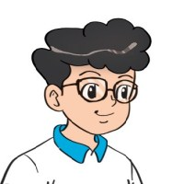
3. Let’s talk.
Ask and answer questions about a book, a story
or a character.
What kinds of stories do you like?
comic books
I like ____________.
Conan
What do you think of _______ ?
clever.
I think he's _______

Slide 33
For example:
A: What kinds of stories do you like?
B: I like fairy tales.
A: What’s your favourite story?
B: It’s the story of Mai An Tiem.
A: Who is the main character ?
B: He’s Mai An Tiem.
A: What do you think of Mai An Tiem?
B: I think he’s hard- working.

Slide 34
Play a game: Listen to music and pass the box.

Slide 35
Great!

Slide 36
Wednesday February 22nd, 2023
Unit 14: What happened in the story?
Lesson 2: Part 1,2,3
1/ Vocabulary:
the older brother
: anh trai
intelligent
: thông minh
greedy
: tham lam
The golden Starfruit Tree
: cây khế vàng
2/ Model sentences:
Hỏi đáp quan điểm của ai đó về tính cách một nhân vật.
What do you think of the older brother?
I think he’s very greedy.

Slide 37
Homework
Learn by heart all the new words and
Model sentences.
Write them 3 lines.
Notes:
Facebook : Bùi Liễu
0968142780

