Slide 1
DAI LOC DEPARTMENT OF EDUCATION AND TRAINING
DAI SON PRIMARY AND SECONDARY SCHOOL
WELCOME TO OUR CLASS !
Subject: English 3
Class: 3
Teacher: Nguyen Thi Kim Thuy

Slide 2
Warm-up

Slide 3
GAME: SECRET GIFT
(Hộp quà bí mật)

Slide 5
1. What’s her job ?
She’s ……………
a singer
You are given 2 candies
GO HOME

Slide 6
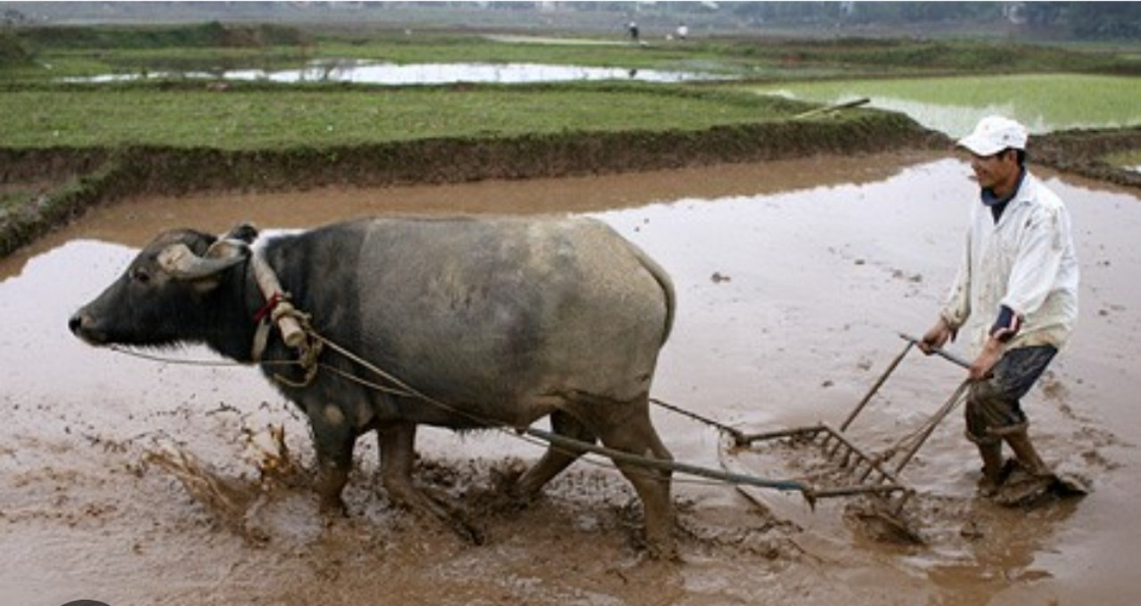
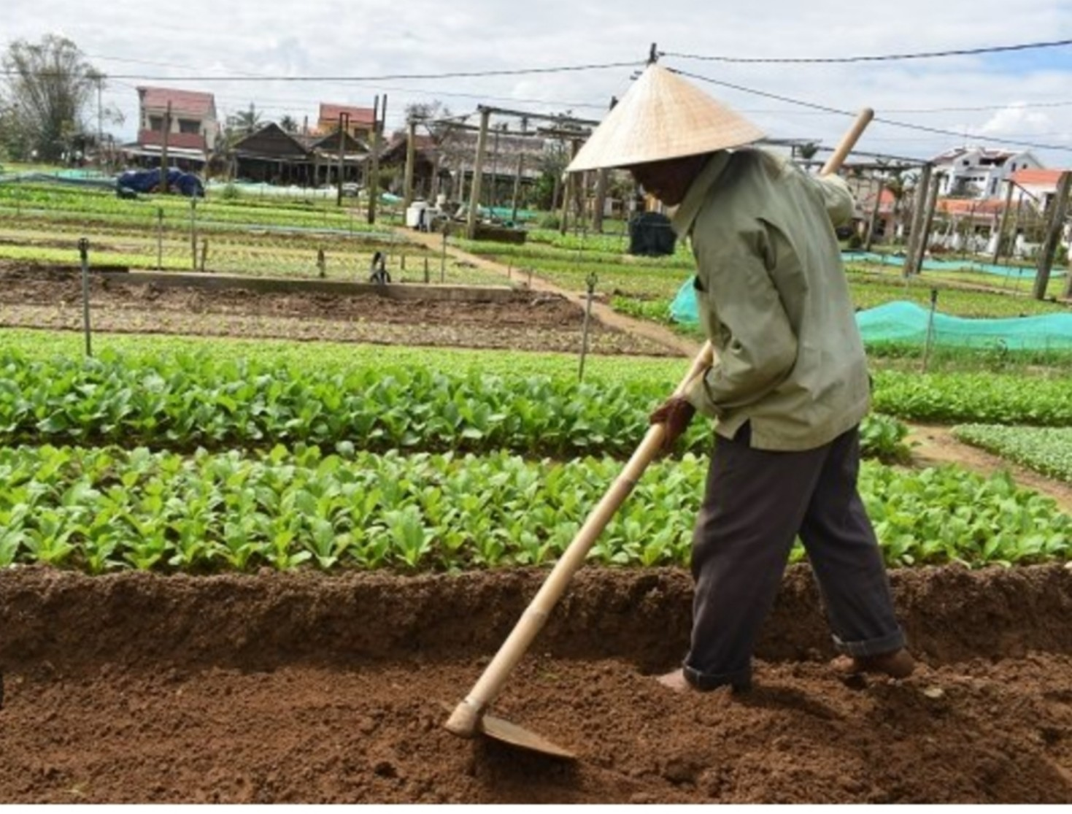
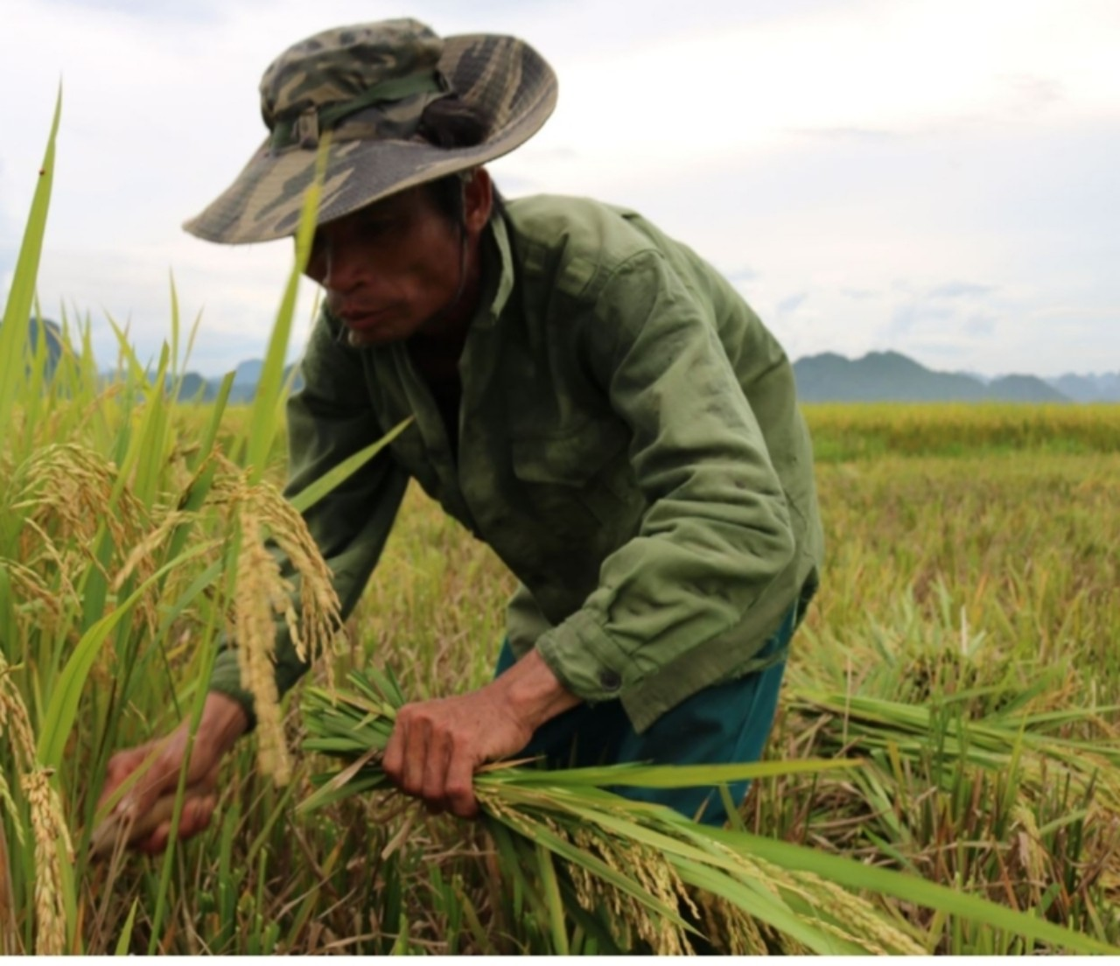
2. What’s his job ?
He’s ……………
a farmer
You are given 1 candies
GO HOME

Slide 7
3. Is he a nurse?
No, he isn’t. He’s a doctor.
You are given 1 candies
GO HOME

Slide 8
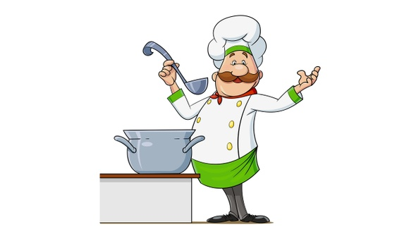
4. What’s his job ?
He’s ……………
a cook
You are given 2 candies
GO HOME

Slide 9
Well done!

Slide 10
Friday, February 10th 2023
Jobs
Unit
12
Lesson 3 ( 4, 5, 6)

Slide 11
Contents
4. Read and complete.
5. Let’s write.
6. Project.

Slide 12
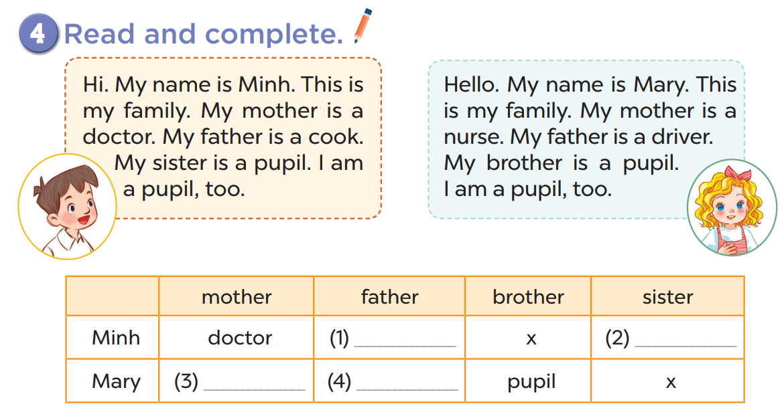

Slide 13
4. Read and complete.

Slide 14
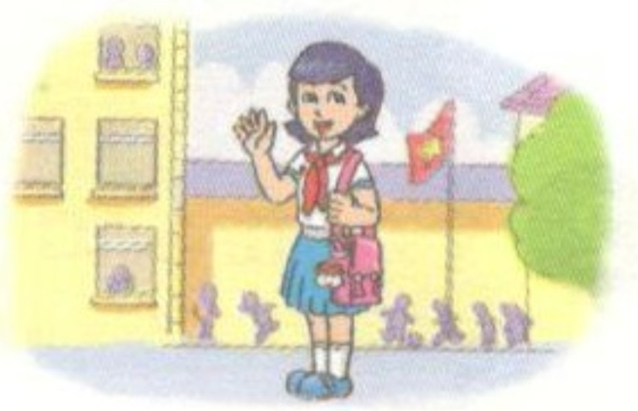
4. Read and complete.
a pupil
/ ‘pju:pl /
học sinh

Slide 15
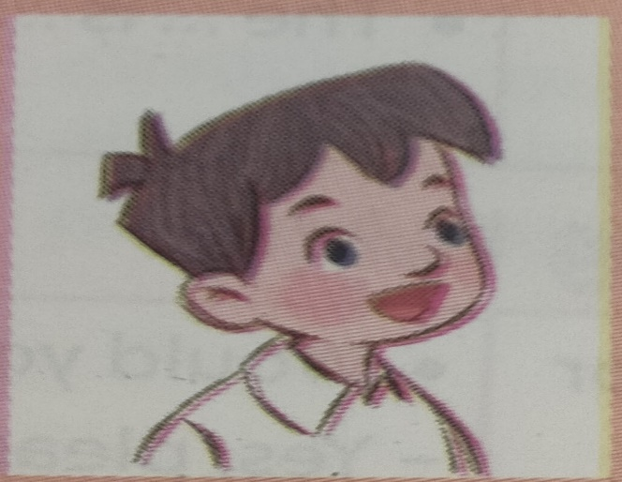
Hi. My name is Minh. This is my family. My mother is a doctor. My father is a cook. My sister is a pupil. I am a pupil, too.

Slide 16
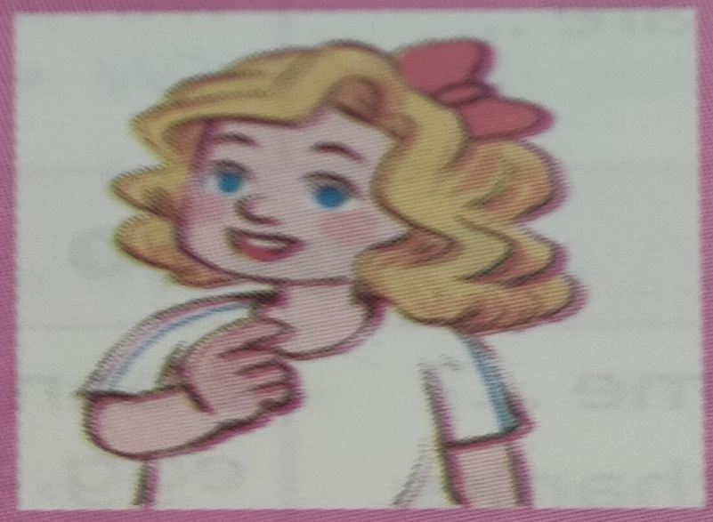
Hello. My name is Mary. This is my family. My mother is a nurse. My father is a driver. My brother is a pupil. I am a pupil, too.

Slide 17
cook
pupil
nurse
driver

Slide 18
Hi, my name is Minh. This is a photo of my family. My mother is ______ .
My father is ______ . I am ___
a doctor
a cook
a pupil

Slide 20
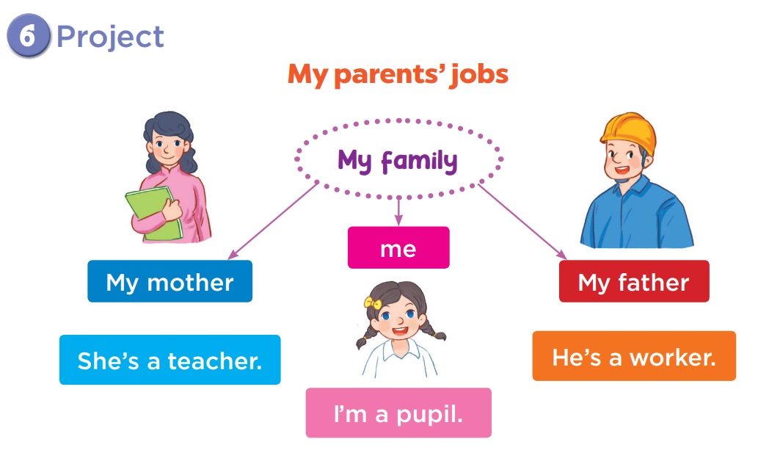

Slide 21
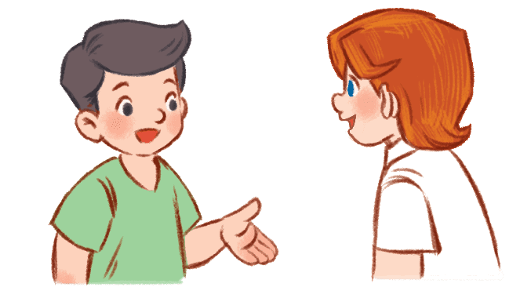
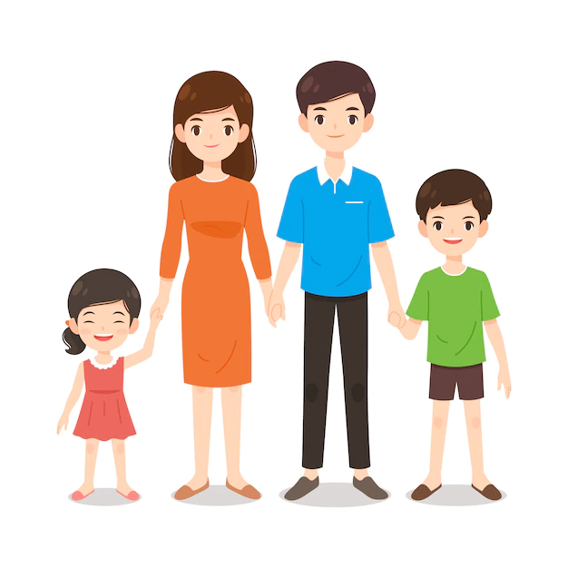
Presentation time!
Hello, my name is ………This is a photo of my family. This is my mother. She’s ……………. This is my father. He’s ______ . And me, I am _______ .

Slide 22
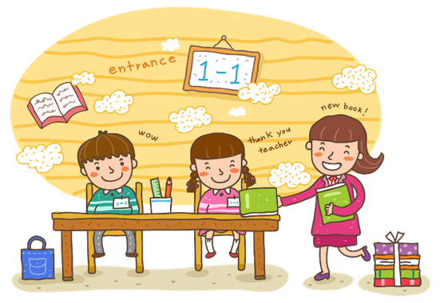
Wrap up

Slide 23
GAME: Pass The Ball
(Chuyền bóng)

Slide 24
1. What is your mother’s job?

Slide 25
1. What is your father’s job?

Slide 26
1. What is your job?

Slide 27
Homework
Practice the presentation.
Prepare the next lesson.

Slide 28
Thank you!

Slide 29
1. What’s her job ?
She’s ……………
a singer
You are given 2 candies
GO HOME

Slide 30
2. What’s his job ?
He’s ……………
a farmer
You are given 1 candies
GO HOME

Slide 31
3. Is he a nurse?
No, he isn’t. He’s a doctor.
You are given 1 candies
GO HOME

Slide 32
4. What’s his job ?
He’s ……………
a cook
You are given 2 candies
GO HOME

