Slide 1
DAI LOC EDUCATION & TRAINING DEPARTMENT
DAI SON PRIMARY AND SECONDARY SCHOOL
WELCOME TO OUR CLASS
Subject : ENGLISH
Unit 8: MY FAVOURITE SUBJECTS
Class : 4A
Teacher : NGUYEN THI KIM THUY

Slide 2
WARM UP

Slide 3
Game: Pass the ball .

Slide 4
NEW LESSON

Slide 5
Wednesday, November 29th, 2023.
Unit 8: My favourite subjects.
Lesson 1: Part 1, 2, 3

Slide 6
Contents
1. Look, listen and repeat
2. Listen, point and say:
3. Let’s talk:

Slide 7
Wednesday, November 29th, 2023.
Unit 8: My favourite subjects.
Lesson 1: Part 1, 2, 3
1/ Look, listen and repeat:

Slide 8
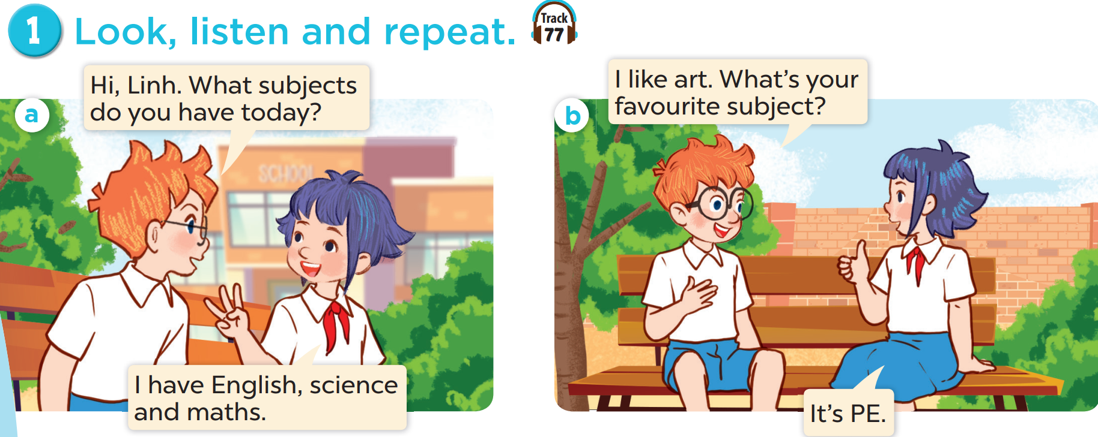
1. Look, listen and repeat:

Slide 9
1. Look, listen and repeat:

Slide 11
1. Look, listen and repeat:

Slide 13
2. Listen, point and say:
* Vocabulary:
IT
/aɪ ˈtiː/
(information technology)
Môn Tin học

Slide 14
2. Listen, point and say:
* Vocabulary:
PE
/piː ˈiː/
(Physical education)
Môn giáo dục thể chất

Slide 15
2. Listen, point and say:
* Vocabulary:
favourite
/’feiv∂rit/
yêu thích

Slide 16
Wednesday, November 29th, 2023.
Unit 8: My favourite subjects.
Lesson 1: Part 1, 2, 3
2. Listen, point and say:
* Vocabulary:
- IT:
môn Tin học
- PE:
môn Giáo dục thể chất
- favourite:
yêu thích

Slide 18
2. Listen, point and say:
* Model sentences: Hỏi môn học yêu thích của bạn:
A: What’s your favourite subject?
B: It’s PE.
Note:
What is =What’s
It is = It’s

Slide 19
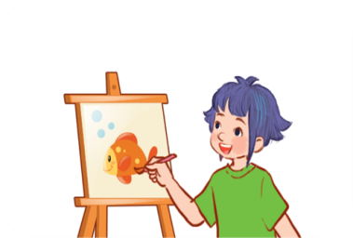
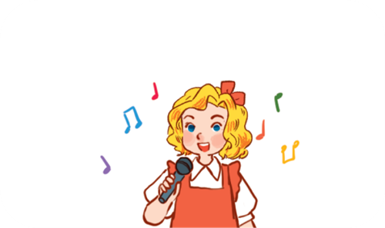
2. Listen, point and say:
a
b
What’s your favourite subject?
art
music
d
c
It’s ______.
PE
IT

Slide 20
2. Listen, point and say:
a
b
What’s your favourite subject?
art
music
d
c
It’s ______.
PE
IT

Slide 21
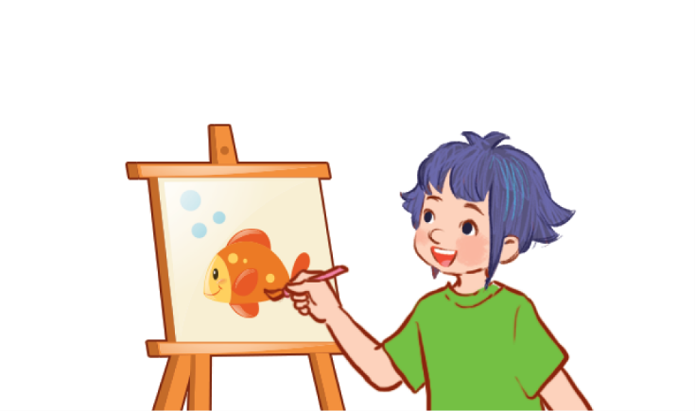
2. Listen, point and say:
a
art
What’s your favourite subject?
It’s art.

Slide 22
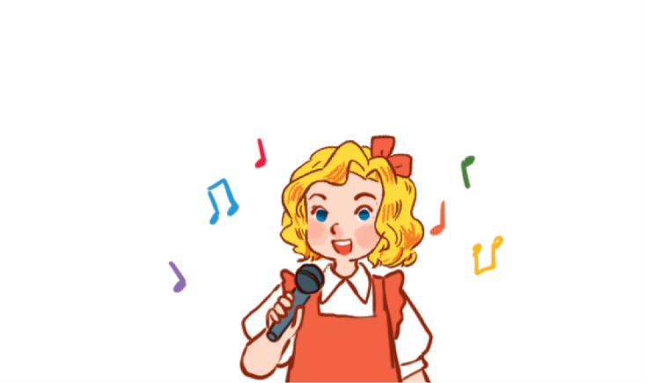
2. Listen, point and say:
b
music
What’s your favourite subject?
It’s music.

Slide 23
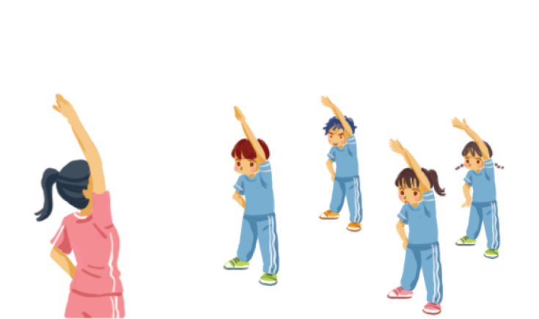
2. Listen, point and say:
c
PE
What’s your favourite subject?
It’s PE.

Slide 24
2. Listen, point and say:
d
IT
What’s your favourite subject?
It’s IT.

Slide 25
3. Let’s talk:
It’s ………………
I like …………….
- My favourite subject is ……..

Slide 26
3. Let’s talk: Example
A: What’s your favourite subject, Ngan?
B: It’s Maths. And you?
A: I like Music.
A: What’s your favourite subject, Ngan?
B: It’s IT. And you?
A: I like drawing. My favourite subject is Art.

Slide 27
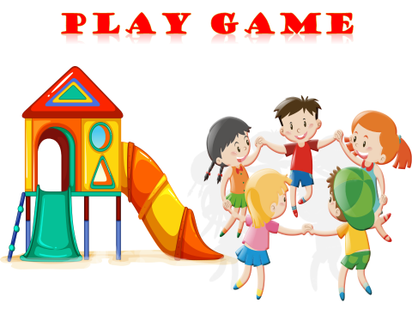
PLAY game

Slide 28
GAME: SECRET GIFT
(Hộp quà bí mật)

Slide 30
Homework
Learn by heart all the new words.
Prepare: Unit 8: Lesson 1: P4,5,6.

Slide 31
Wednesday, November 29th, 2023.
Unit 8: My favourite subjects.
Lesson 1: Part 1, 2, 3
1. Vocabulary:
- IT: môn Tin học
- PE: môn giáo dục thể chất
- favourite: yêu thích
2. Model sentences: Hỏi môn học yêu thích của bạn:
A: What’s your favourite subject?
B: It’s PE.
Note:
What’s = What is
It’s = It is

Slide 32
1. What’s her favourite subject?
It’s ………
music
2 candies
GO HOME

Slide 33
2. What’s your favourite subject?
My favourite subject is …
art
1 candy
GO HOME

Slide 34
3. What’s your favourite subject?
I like ………
English
1 candy
GO HOME

Slide 35
4. What’s his favourite subject ?
It’s …
IT
2 candies
GO HOME

